Slide 1
Software Cluster Project Part 1
Uncle Eats
Isaac Tan
2100902B

Slide 2
Site Navigation Map
HOME
Restaurant List
Login
Register
Filter
See More
Restaurant Information
Review Site
More of Restaurant List of that Category
Post and View Reviews

Slide 3
Functionalities and Web Application
Login/Register – for user to login or register their account so they can continue using the website
Filter space (home page) - for user to filter the restaurant places to their liking
See more – for user to see more of the restaurants listed in the category
Search bar – for user to search for a particular restaurant in the entire webpage
Sort (in reviewing page) – for user to sort the reviews to however the user likes – in a list of highest to lowest rating or most recent to earliest rating
Post your review – for user to post review, within 500-character word limit and having image icon to post image, and also having 5 stars for user to choose how many stars to rate
Edit and delete – for user to edit or delete their reviews, if something is wrong - e.g., typo error or posted review in wrong restaurant
Restaurant information – for user to know more about the restaurant, opening hours and location of restaurant with a small map at the side for easier reference, price and rating, category, restaurant link, and also if it is halal or not – for the Muslims

Slide 4
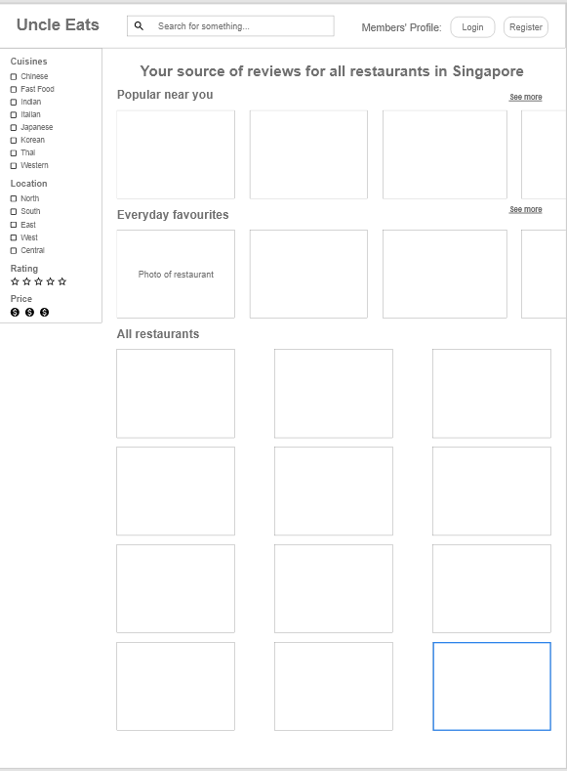
Wireframes (Home Page)

Slide 5
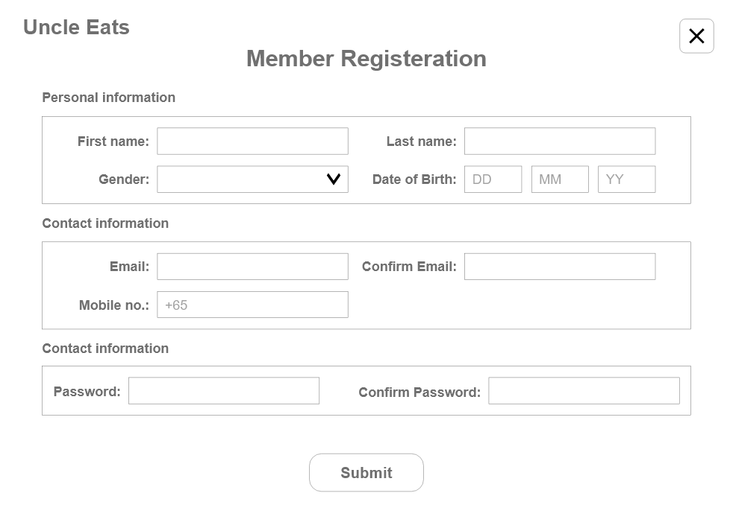
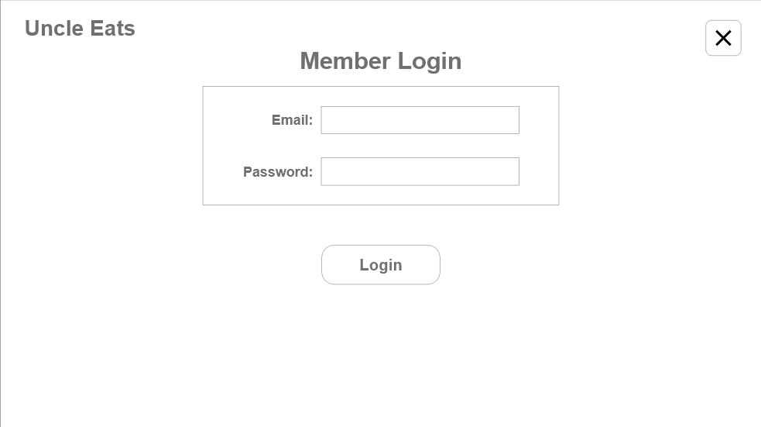
Wireframes (Login/Register Page)

Slide 6
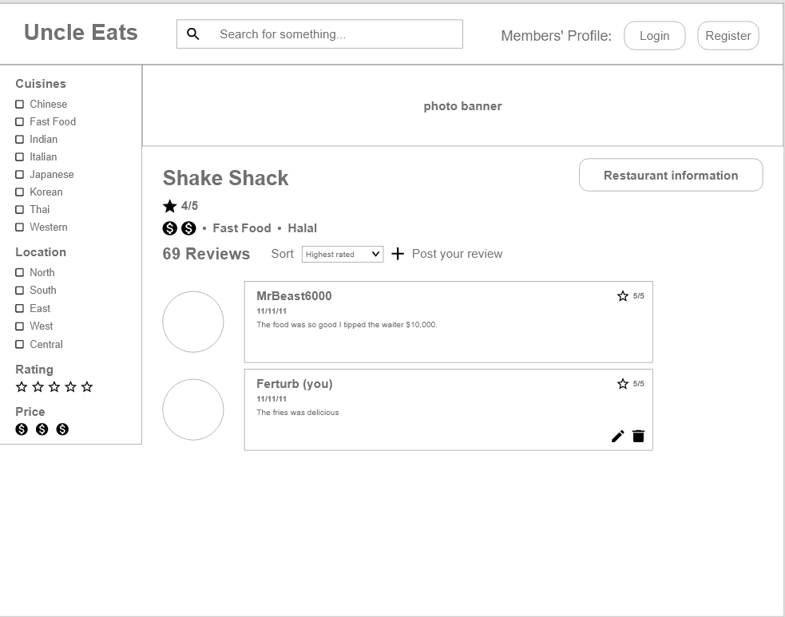
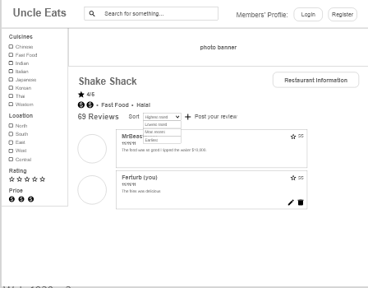
Wireframes (Review Page + Sort)

Slide 7
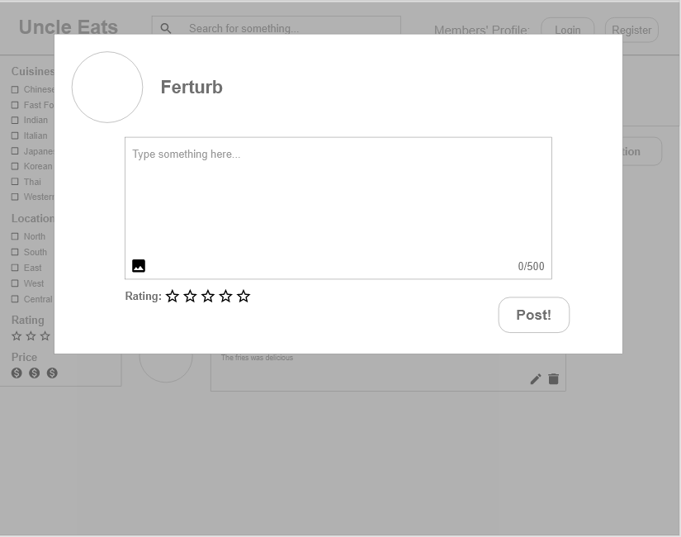
Wireframes (Posting Review)

Slide 8
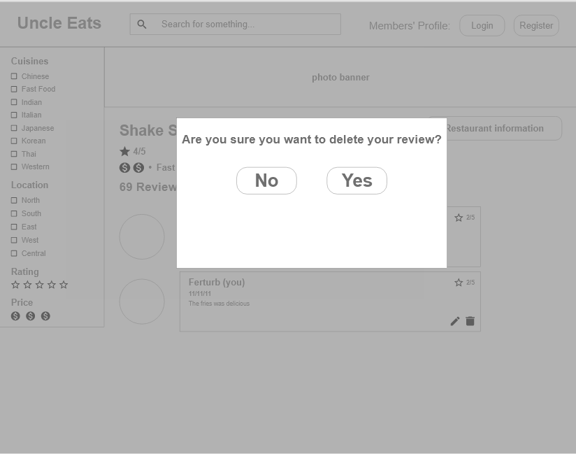
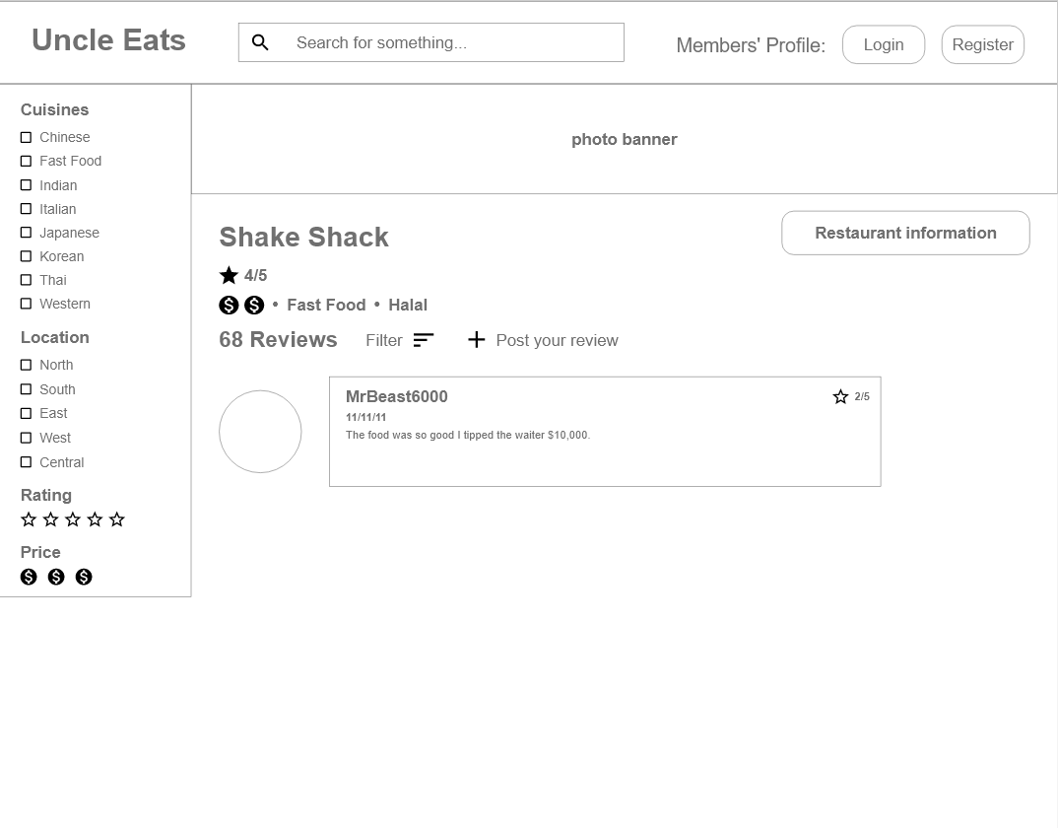
Wireframes (Delete Review)

Slide 9
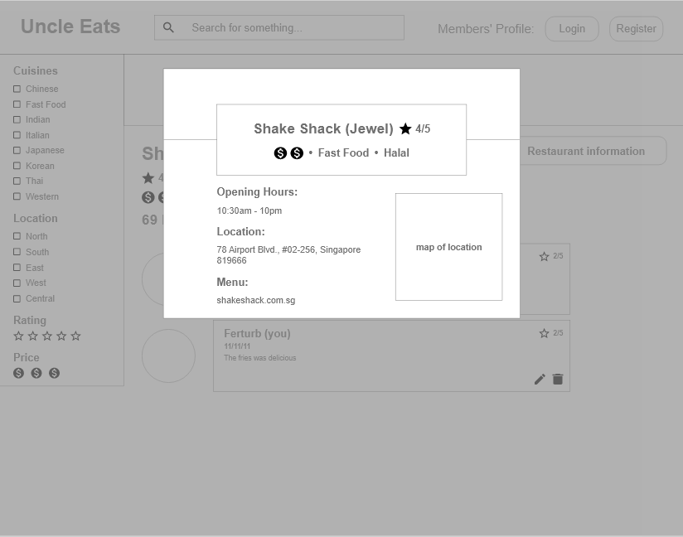
Wireframes (Restaurant Information)

Slide 10
References
Foodpanda
Golden Village
Amazon

